Slide 1
Anti-Virus
Computer Viruses and Malware
By
John Aycock

Slide 2
Anti-Virus
Three tasks for anti-virus
Detection
Identification
Disinfection
Remove the virus

Slide 3
Detection: Static Methods
Generic methods
Detects known and unknown viruses
For example, anomaly detection
Virus-specific methods
Detects known viruses
For example, signature detection
Static --- virus code not running
Dynamic --- virus code running

Slide 4
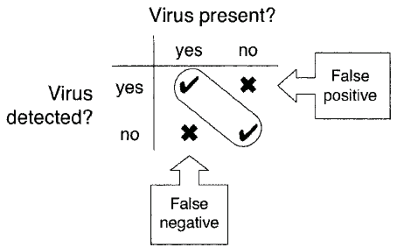
Detection Outcomes

Slide 5
Detection Outcomes
Also can have ghost positive
Virus remnant “detected”
But virus is no longer there
How can this happen?
Previous disinfection was incomplete

Slide 6
Static Detection
Detection without running virus code
Three approaches…
Scanners
Signature
Heuristics
Look for “virus-like” code
Integrity Checkers
Hash/checksum

Slide 7
Scanners
On-demand
Files scanned when you say so
On-access
Constant scanning in background
Whenever file is accessed, it’s scanned

Slide 8
Scanners
Signature scanning
Viruses represented by “signature”
Signature == pattern of bits in a virus (might include wildcards)
“Hundreds of thousands of signatures”
Not feasible to scan one-by-one
Multiple pattern search
Efficiency is critical
We look in detail at several algorithms

Slide 9
Algorithm: Aho-Corasick
Developed 1975, bibliographic search
Based on finite automaton (graph)
Circles are search states
Edges are transitions
Double circles are final states/output
And a failure function
What to do when no suitable transition
I.e., where to resume “matching”

Slide 10
Algorithm: Aho-Corasick
When virus scanning, search for virus signature, which is bit string
For simplicity, illustrate algorithm using English words
For our example…
Scan for any of the following words:
hi, hips, hip, hit, chip

Slide 11
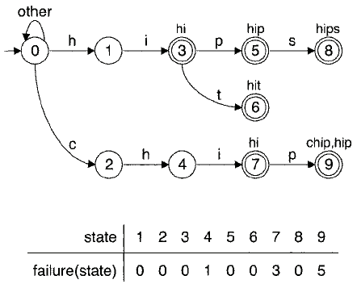
Algorithm: Aho-Corasick

Slide 12
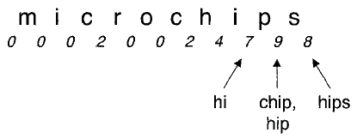
Aho-Corasick Example

Slide 13
Algorithm: Aho-Corasick
How to construct automaton?
And failure function
Build the automaton --- next slide
A “trie”, also known as a “prefix tree”
Then determine failure function

Slide 14
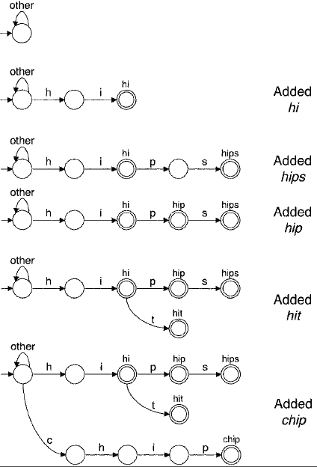
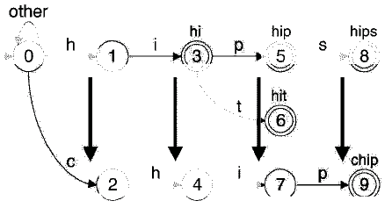
Aho-Corasick: Trie
Labels added in breadth-first order
Closest to root get smallest numbers

Slide 15
Aho-Corasick: Failure Function
Depth 1 nodes
Fail goes back to start state
For other states
Go back to earliest place where search can resume

Slide 16
Aho-Corasick
The bottom line…
Linear search that can find multiple signatures
Efficient representation of automaton is the challenge
Both time and space issues

Slide 17
Algorithm: Veldman
Linear search on “reduced” signatures
Sequential search on reduced set
From each signature, select 4 adjacent non-wildcard bytes
Want as many signatures as possible to have each selected 4-byte pattern
Then use 2 hash tables to filter…
Hash tables: 1st 2 bytes & 2nd 2 bytes

Slide 18
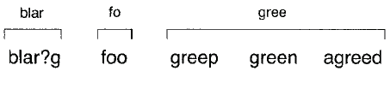
Algorithm: Veldman
Example
Suppose the following 5 signatures
blar?g, foo, greep, green, agreed
Select 4-byte patterns, no wildcards:

Slide 19
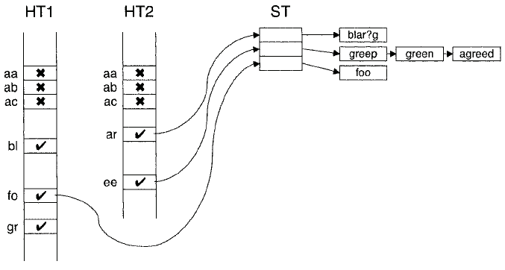
Algorithm: Veldman
Hashes act as filters
Test things that pass thru both filters
In this example, things like “grar” will get through hash but removed later

Slide 20
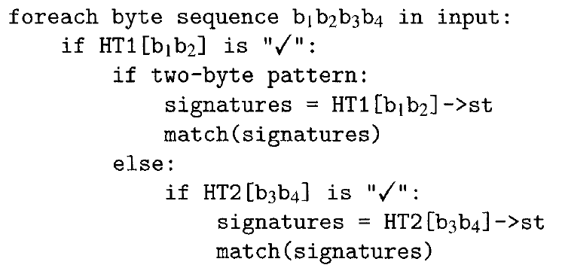
Algorithm: Veldman

Slide 21
Algorithm: Veldman
Veldman allows for wildcards and complex signatures
Aho-Corasick does not
But both algorithms analyze every byte of input
Is it possible to do better?
That is, can we skip some of the input?

Slide 22
Algorithm: Wu-Manber
Like Veldman’s algorithm
But can skip over bytes that can’t possibly match
Faster, improved performance
Illustrate algorithm with same signatures used for Veldman’s:
blar?g, foo, greep, green, agreed

Slide 23
Algorithm: Wu-Manber
Calculate MINLEN
Min length of any pattern substring
Two hash tables
SHIFT --- number of bytes that can safely be skipped
HASH --- mapping to signatures
Input bytes denoted b₁,b₂,…,b_{n}
Start at b_{MINLEN} consider byte pairs

Slide 24
Algorithm: Wu-Manber
How to construct hash tables?
It’s a 4-step process
Calculate MINLEN
Initialize SHIFT table
Fill SHIFT table
Fill HASH table

Slide 25
Algorithm: Wu-Manber
Calculate MINLEN
Minimum number of adjacent, non-wildcard bytes in any signature
For this example, we have
blar?g 4 foo 3
greep 5 green 5
agreed 6
So we have MINLEN = 3

Slide 26
Algorithm: Wu-Manber
SHIFT table
Extract MINLEN pattern substrings
blar?g bla foo foo
greep gre green gre
agreed agr
Extract all distinct 2-byte sequences
bl, la, fo, oo, gr, re, ag
If input pair is not one of these, safe to skip MINLEN - 1 bytes

Slide 27
Algorithm: Wu-Manber
SHIFT table
Initialize SHIFT table to MINLEN – 1
For 2-byte pairs: bl, la,fo,oo,gr, re,ag
Denote as xy
Let q_{xy} be rightmost ending position of xy in any pattern substring
For example, gr in agr and gre, but bl in bla
So, q_{gr} = 3 while q_{bl} = 2
Then set SHIFT[xy] = MINLEN – q_{xy}
Note: Wildcard matches everything…

Slide 28
Algorithm: Wu-Manber
HASH table
If SHIFT[xy] = MINLEN – q_{xy} = 0
Then we are at right edge of a pattern
So, set HASH[xy] to all signatures with pattern substring ending xy
For example
HASH[gr] → agreed
HASH[re] →greep, green

Slide 29
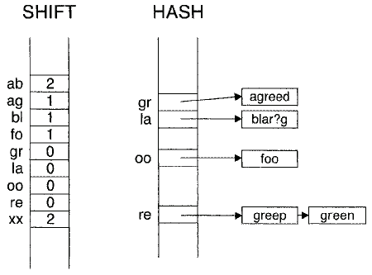
Algorithm: Wu-Manber
Example: Suppose hash tables are…

Slide 30
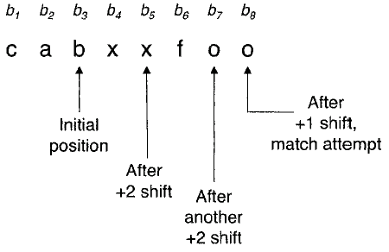
Wu-Manber Example
Here, MINLEN = 3
Start at b_{MINLEN}

Slide 31
Algorithm: Wu-Manber
Here, we illustrated simplest form of the algorithm
More advanced forms can handle 10s of thousands of signatures
Worst case performance is terrible
Sequential search thru every byte of input for every signature…
But tests show it’s good in practice

Slide 32
Improving Performance
“Grunt scanning” --- scan everything
Slow slow slow
Search only beginning and end of files
Scan code entry point
And points reachable from entry point
If position of virus in file is known…
Make it part of the “signature”
Limit scans to size of virus(es)

Slide 33
Improving Performance
Only scan certain types of files
Not so viable today
Only rescan files that have changed
How to detect change?
Where to store this info? Cache? Database? Tagged to file?
Updates to signatures? Must rescan…

Slide 34
Improving Performance
Heuristic Scanning: Instead of looking for an exact match to an already identified threat, a heuristic scan looks for certain crucial components the threat might share, increasing the chances of detecting and stopping a new variation of the virus.
Behavior-based Detection: This type of antivirus function analyzes the behavior of a virus rather than only looking at its actual code.

Slide 35
Static Heuristics
Like having expert look at code…
Look for “virus-like” code
Static, so we don’t execute the code
2 step process
Gather data
Analyze data

Slide 36
Static Heuristics
What data to gather?
“Short signatures” or boosters
Junk code
Decryption loop
Self-modifying code
Undocumented API calls
Unusual/non-compiler instructions
Strings containing obscenities or “virus”
Stopper --- thing virus would not do

Slide 37
Integrity Checkers
Look for unauthorized change to files
Start with 100% clean files
Compute checksums/hashes
Store checksums
Recompute checksums and compare
If they differ, a change has occurred

Slide 38
Detection: Dynamic Methods
Detection based on running the code
Observe the “behavior”
Two type of dynamic methods
Behavior monitor/blockers
Emulation

Slide 39
Behavior Monitor/Blocker
Monitor program as running
Watch for “suspicious” behavior
What is suspicious?
It’s too far from “normal”
What is normal?
A statistical measure --- mean, average
How far is too far?
Depends on variance, standard deviation

Slide 40
Behavior Monitor/Blocker
“Normal” monitored in 3 ways…
Actions that are permitted
White list, positive detection
Actions that are not permitted
Black list, negative detection
Some combination of these two
Analogies to immune system
Distinguish self from non-self

Slide 41
Behavior Monitor/Blocker
“Care must be taken… because anomalous behavior does not automatically imply viral behavior”
That’s an understatement!
This is the fundamental problem in anomaly detection
Potential for lots of false positives

Slide 42
Behavior Monitor/Blocker
Look for short “dynamic signatures”
Like signature detection, but input string generated dynamically
But what to monitor?
Infection-like behavior?
Open an exe for read/write
Read code start address from header
Write start address to header
Seek to end of exe, append to exe, etc.

Slide 43
Emulation
Execute code, but not for real…
Instead, emulate execution
Emulation can provide all of the info gotten thru code execution
But much safer
“Execute” code in emulator
Gather info for static/dynamic signatures or heuristics
Behavior blocker stuff applies too

Slide 44
Comparison of Techniques
Recall, the techniques considered…
Scanning
Static heuristics
Integrity check
Behavior blocker
Emulation

Slide 45
Comparison of Techniques
Scanning
Pros:
Precise ID of malware
Cons:
Requires up-to-date signatures
Cannot detect new/unknown malware

Slide 46
Comparison of Techniques
Static heuristics
Pros:
Detect known and unknown malware
Cons:
Detected malware not identified
False positives

Slide 47
Comparison of Techniques
Integrity check
Pros:
Can be efficient and fast
Detect known and unknown malware
Cons:
Detected after infection & not identified
Can’t detect in new/modified file
Heavy burden on users/admins

Slide 48
Comparison of Techniques
Behavior blocker
Pros:
Known and unknown malware detected
Cons:
Probably won’t identify malware
High overhead
False positives
Malware runs on system before detected

Slide 49
Comparison of Techniques
Emulation
Pros:
Known, unknown, polymorphic detection
Malware executed in “safe” environment
Cons:
Slow
Malware might outlast emulator
Might not provide identification

Slide 50
Detection: Bottom Line
Static analysis is fast
Good approach when it works
Dynamic analysis can “peel away a layer of obfuscation”
Dynamic analysis is relatively costly
Specialized virus detector language are used for maintaining databases of viruses

Slide 51
Verification, Quarantine, Disinfect
What to do after virus detected?
Verify that it really is a virus
Quarantine infected code
Disinfect --- remove infection
These are done rarely, so can be slow and costly in comparison to detection

